Slide 1
Intrusion Detection in O-RAN

Slide 2
Contents
O-RAN : architecture, interfaces, algorithms, security and research challenges.
An efficient intrusion detection solution for Near-Real-Time Open-RAN.
Robust intrusion detection system with explainable artificial intelligence.
Roadmap for integrating Open RAN and AI for intrusion detection system in 6G networks.
AI-Driven network intrusion detection and resource allocation in real world O-RAN 5G networks.
A survey for intrusion detection systems in Open RAN.

Slide 3
O-RAN Survey
Polese, Michele, et al. "Understanding O-RAN: Architecture, interfaces, algorithms, security, and research challenges." IEEE Communications Surveys & Tutorials 25.2 (2023): 1376-1411.

Slide 4
Overview
Disaggregation – in telecom divides the base station into three parts:
Radio Unit (RU): It captures radio signals and converts them into digital signals.
Distributed Unit (DU): Handles real-time data processing near users for fast, reliable data transfer.
Central Unit (CU): Manages tasks like security, traffic flow, and quality of service, typically located farther from users.
This setup improves flexibility and reduces latency by placing each unit where it is most effective no matter where you are and what you are doing, connection is optimized for speed, security and reliability.
RAN Intelligent Controllers and Closed-Loop Control – software components introduced in O-RAN to make it smarter, programmable. There are two types of RIC’s
Near-Real-Time RIC (Near-RT RIC) – operates at ~10ms to 1 second timescale (fast, real-time, tactical decisions)
Non-Real-Time RIC (Non-RT RIC) – operates at >1 second timescale (slow, long-term, strategic decisions)
Works using data and AI decision making.
Virtualization – The O-Cloud shifts the RAN from specialized, expensive, vendor-controlled hardware to flexible, programmable, cloud-based infrastructure. This is what makes network disaggregation and openness truly possible.

Slide 5
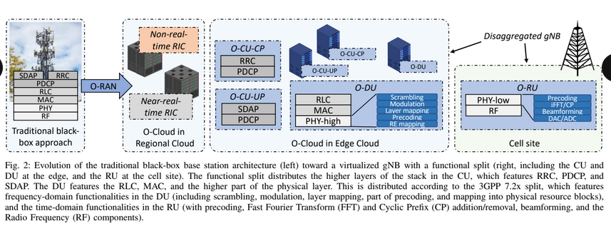

Slide 6
An Efficient Intrusion Detection Solution for Near-Real-Time Open-RAN
Amachaghi, Emmanuel N., et al. "An Efficient Intrusion Detection Solution for Near-Real-Time Open-RAN." 2024 IEEE Symposium on Computers and Communications (ISCC). IEEE, 2024.

Slide 7
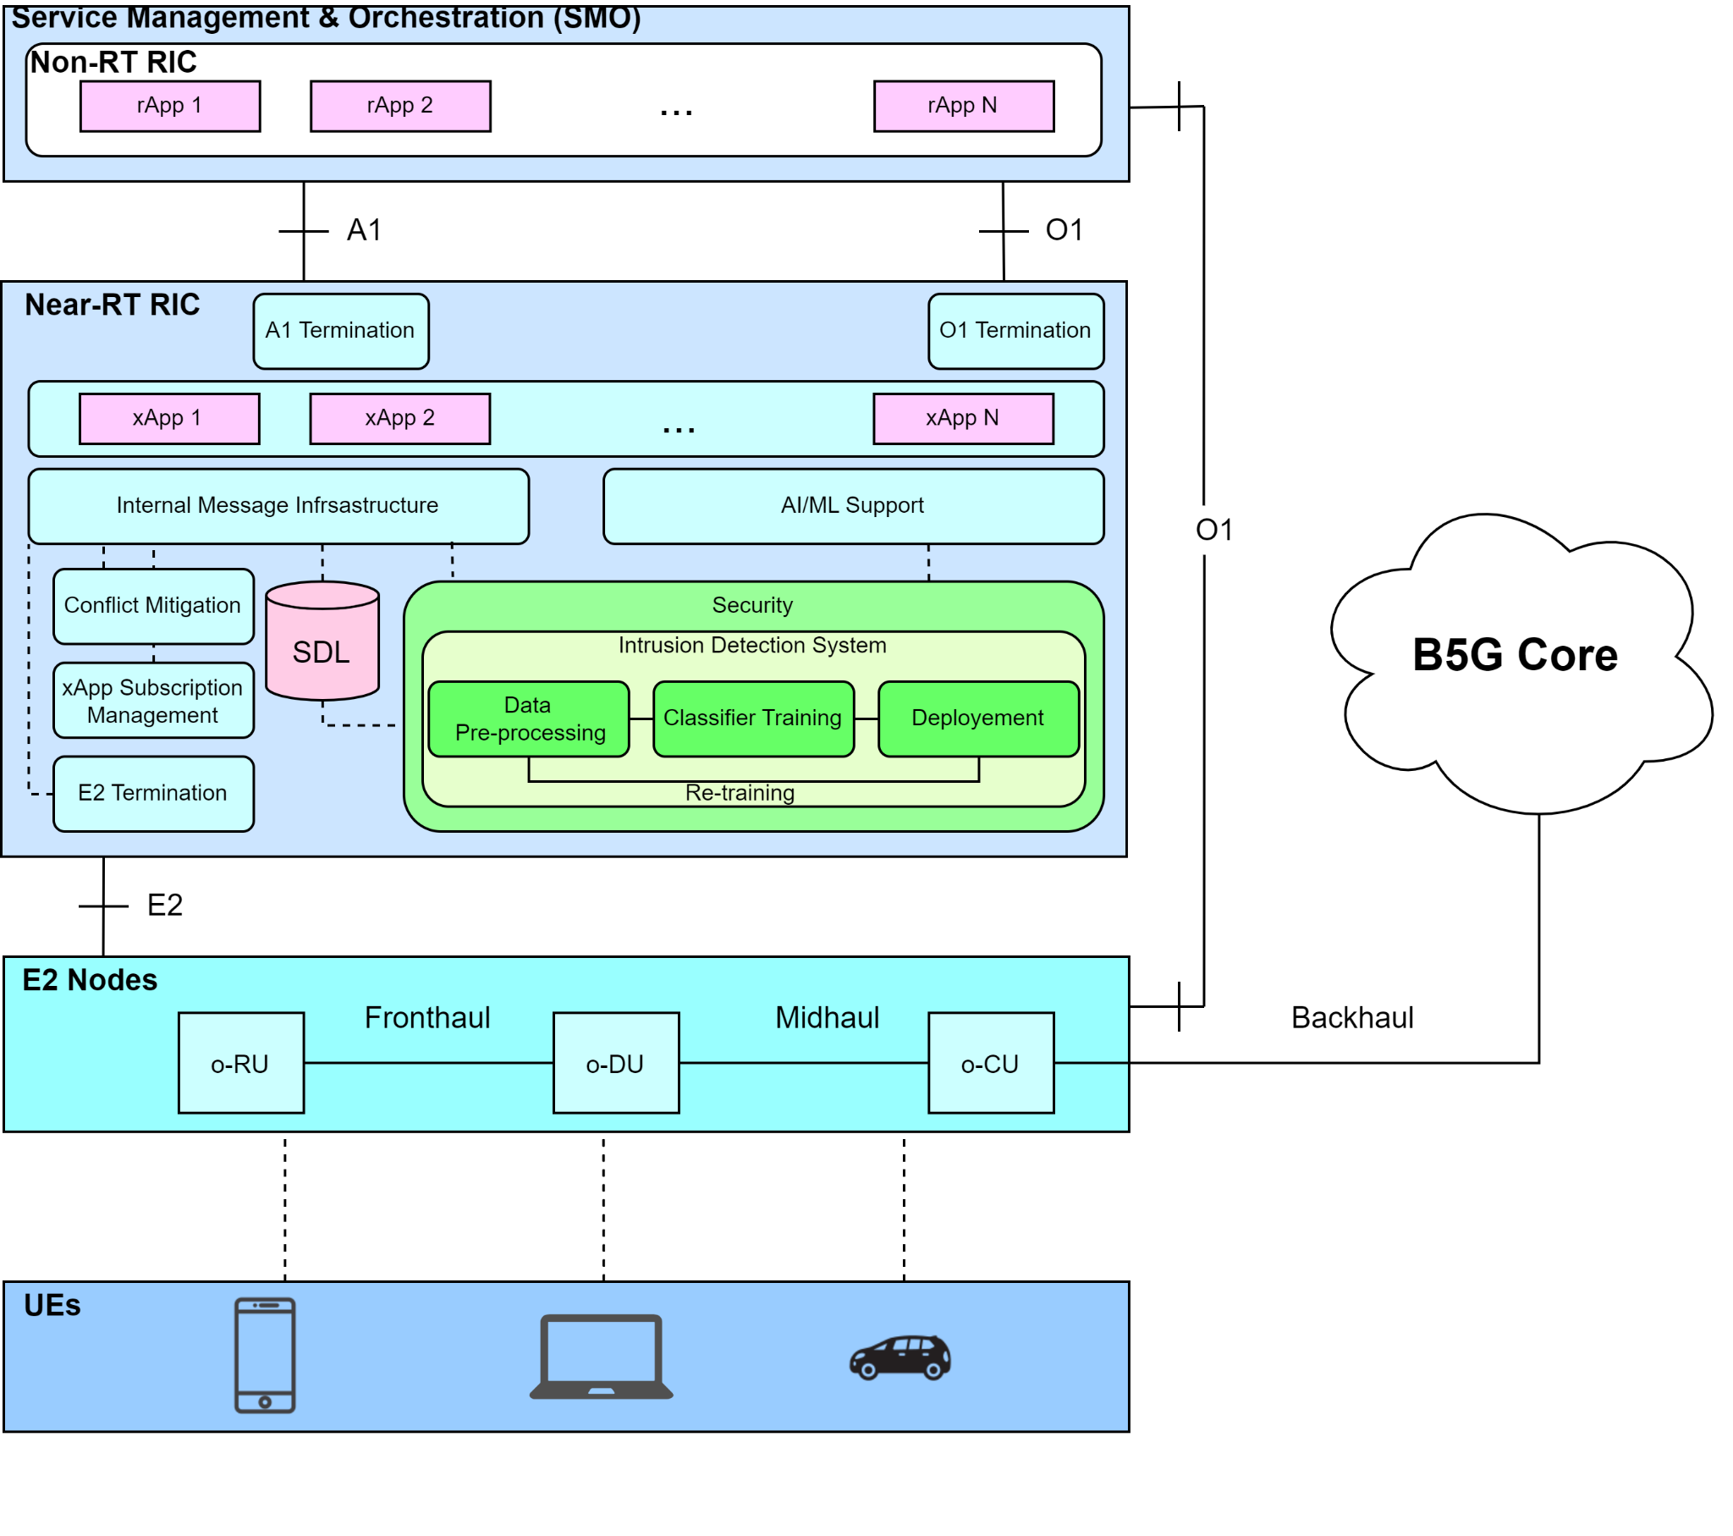
How the Data is being fed to the xApp
Data Traffic from the UE is captured and stored in the SDL.
Data is send to the IDS using the API’s provided by SDL.
After data gathering pre-processing is done.
Then the it is fed into the AI/ML Model
After training it is deployed for doing IDS
It is continuously being retrained.

Slide 8
Robust Intrusion Detection System with Explainable Artificial Intelligence
Paltun, Betül Güvenç, Ramin Fuladi, and Rim El Malki. "Robust Intrusion Detection System with Explainable Artificial Intelligence." arXiv preprint arXiv:2503.05303 (2025).

Slide 9
Overview
The paper address vulnerability of machine learning based intrusion detection system to adversarial attacks.
Explainable AI is used to detect real time and understand adversarial attacks within IDS framework.

Slide 10
Major Contributions
Integration of XAI to defend adversarial attack – this system operates in both black box & white box scenario with limited feature sets, ensuring adversarial attacks are handled even with constrained data.
Adversarial attack detection with minimal features : It overcomes the issue of requiring integration during training phase (which is vulnerable to attackers analyzing the model) & needing huge amount of data to detect.
Differentiating between high load and malicious scenarios

Slide 11
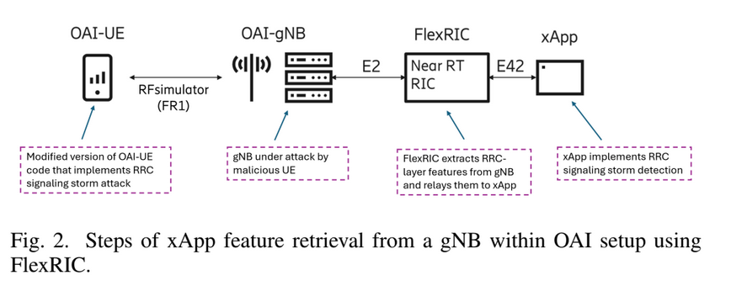
Setup methodology and AI
Tools and software used to setup
OAI – provides a realistic environment to simulate 5G RRC signaling process.
FlexRIC and xApp: These tools allow for real-time RAN control and feature extraction, which are essential for detecting RRC signaling storm attacks
Customizable UE and gNB: UE is modified to perform malicious attacks to simulate various attacks.
Support for XAI (SHAP): XAI methods, like SHAP, are integrated into the setup to enhance transparency

Slide 12
RRC signaling storm & xAI
Scenario: RRC Signaling Storm Attack Disguised as Normal Traffic
The Attack: An RRC (Radio Resource Control) signaling storm happens when a device repeatedly sends connection requests (RRC setup/release) to the network, overloading the CU (Centralized Unit).
Often caused by misbehaving apps or deliberate attacks.
Attackers mimic normal UE behavior: low packet sizes, short bursts, realistic timings.
Goal: Evade detection and slowly degrade network performance.

Slide 13

IDS model : Autoencoder
Trained on normal behaviour
Learns to reconstruct normal input data (low reconstruction error)
During an attack, reconstruction error increases sharply → flagged as anomaly
The attacker crafts the data to mimic normal behaviour closely enough to avoid triggering high reconstruction error in the autoencoder.
This is a critical challenge in anomaly detection especially with autoencoders – they can be bypassed if the attacks are adversarially crafted.

Slide 14
Example
ML model input example :
Feature Value
Protocol RRC
Packet size 80 bytes
RRC Connection attempts 6 per second
Average session duration 0.5 seconds
Time of activity 3 PM
Destination node CU
Uplink traffic volume Low (5 KB/s)
Model Prediction: Normal
Confidence: 0.81 (81%)
!! but is it actually malicious, the attacker is using a botnet to generate frequent, short-lived sessions to flood the control plane, traffic looks normal but the intent and frequency are abnormal.

Slide 15
SHAP value breakdown :
Feature SHAP Value (Impact on Normal)
Packet size: 80 bytes : +0.25 (typical for RRC requests)
Time: 3 PM : +0.15 (normal business hours)
Uplink volume: Low +0.20 (low traffic seems safe)
RRC attempts: 6/sec -0.35 (suspicious spike)
Session duration: 0.5 sec -0.15 (too short, repeated)
Destination: CU -0.06 (not unusual alone)
Base value (avg malicious prob): 0.50
Final model prediction (Normal): 0.81
SHAP reveals several small negative influences being overridden by high-trust features.

Slide 16
Experimental evaluation
The proposed framework detects the potential adversarial attacks by observing significant deviations in the distribution of SHAP values for each input in real-time.
IDS is developed using auto-encoder, if the anomaly exist in the test data, the reconstruction error will be high.
Experiment settings
1 malicious UE
No benign UE
gNB (5g base station) : can handle 16 simultaneous resource allocations

Slide 17
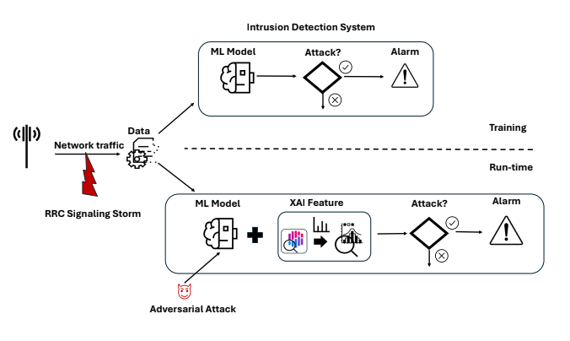
System Architecture

Slide 18
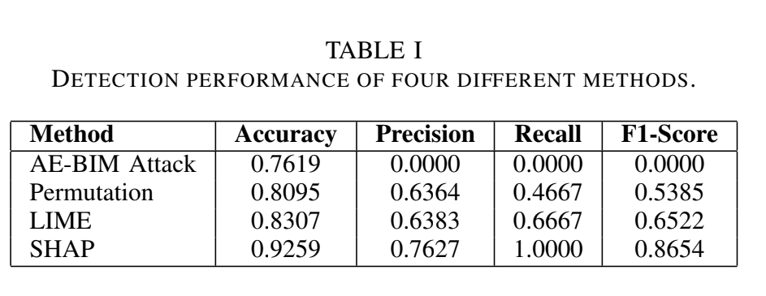
Performance results :

Slide 19
Roadmap for Integrating Open RAN and AI for Intrusion Detection Systems in 6G Networks
Ahakonye, Love Allen Chijioke, Cosmas Ifeanyi Nwakanma, and Dong-Seong Kim. "Roadmap for Integrating Open RAN and AI for Intrusion Detection Systems in 6G Networks." 2024 15th International Conference on Information and Communication Technology Convergence (ICTC). IEEE, 2024.

Slide 20
Overview
Proposed a conceptual framework for deploying an IDS at strategic points.
The IDS components are placed at critical locations (RIC, fronthaul interfaces, etc), introduced a federated learning approach to train IDS models ensuring data privacy & scalable model improvement.
Used IIoT dataset to validate its effectiveness.

Slide 21
Major Contributions
Integrated security evaluations and response mechanisms for the distributed and open nature of O-RAN.
Co-ordinated IDS architecture, not just risk assessments or conceptual risks. – Letting both AI and traditional IDS modules share data and alerts, improving decision making.
The IDS is deployed at the following locations: (possible attacks based on Edge IIoT dataset)
Near-RT RIC – to monitor E2 communication and xApp behavior.
MITM Attack: Simulates E2 interface interception or injection.
SQL Injection: Maps to policy injection in xApp APIs.
Spoofing Attack: Matches rogue xApp or E2 node identity spoofing.
ODU/OCU – to monitor access and traffic.
DoS/DDoS Attacks (TCP, UDP, ICMP Flood): Targeting DU/CU to exhaust processing.
Spoofing Attack: Fake UE or rogue base station behavior.
Port Scanning: Recon of DU ports/services before intrusion.

Slide 22
OFH Interface – to inspect control and synchronization plane traffic.
MITM: Intercepting RU-to-DU traffic (control/sync).
Spoofing Attack: Mimicking RU to send malicious sync data.
Injection Attacks: Altering PTP or control-plane messages.
xApp/rApp environments – to monitor application behavior and data access.
Malware / Trojan Activity: Malicious or compromised xApp/rApp behavior.
SQL Injection: Exploiting API endpoints for data leakage or manipulation.
Reconnaissance (Port Scan): xApp probing network state unauthorizedly.
Management Interfaces – to detect unauthorized changes or DoS attacks.
Brute Force Attack: Against admin login or REST APIs.
SQL Injection: Through management web interfaces.
DoS/DDoS: Flooding CLI/API ports to degrade control.
User Plane Traffic – to analyze control messages and data.
MITM Attack: Manipulating user data or signaling traffic.
Spoofing Attack: User identity manipulation (IMSI/IMEI spoofing).
Malware Command & Control: Encrypted C2 channels via data plane.
Central Monitoring Unit – for data aggregation, analysis, and coordinated response.
Data Poisoning / MITM: Corrupting telemetry during ingestion.
DDoS: On log collection APIs.
Reconnaissance: Identifying weak points in the monitoring layer.

Slide 23
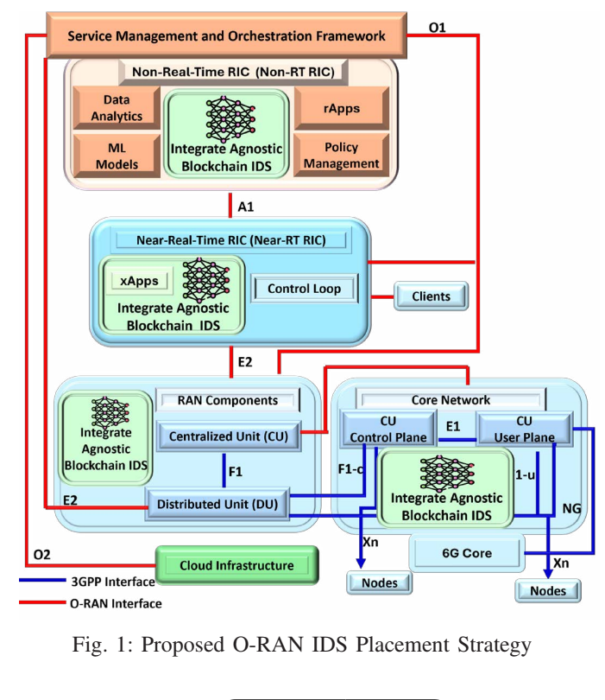
System Architecture

Slide 24
AI/ML methods & Strategy
Federated learning strategy :
Each client (IDS sensor) trains a local model using its data
Gradients are aggregated centrally without sharing raw data.
A global model is updated iteratively
Each node operated independently but collaborates through secure, scalable mechanisms
IDS placement and federated training are both handled programmatically –

Slide 25
Setup & methodology
Setup
Dataset: Edge-IIoTset (public dataset for IoT/IIoT cyberattack simulations)
Programming Language: Python 3.6.13
Hardware: Intel(R) Core(TM) i5-8500 CPU @ 3.00GHz, 8GB RAM
Operating System: Windows 11
Development Tools: Visual Studio Code
Federated learning configuration:
Number of clients: 5 and 10
Training rounds: 10
IDS sensors: Devices treated as federated clients for training
Dataset includes 62 predictors and 15 classification labels, simulating diverse attack scenarios.

Slide 26
AI-Driven Network Intrusion Detection and Resource Allocation in Real-World O-RAN 5G Networks
Tsourdinis, Theodoros, et al. "AI-Driven Network Intrusion Detection and Resource Allocation in Real-World O-RAN 5G Networks." Proceedings of the 30th Annual International Conference on Mobile Computing and Networking. 2024.

Slide 27
Overview
Presented a AI/ ML Driven Network Intrusion Detection framework with dynamic resource allocation in O-RAN
Classification of user traffic (benign/ malicious) based on a ML model (trained on KDDCup99 Dataset)
Mitigation of DoS Attacks through an xApp that classifies network traffic in real-time and dynamically adjust network resources for each user
Used OAI and FlexRIC for the testbed

Slide 28
Major Contributions: ATD Training
Trained on KDDCup99 Dataset
This Dataset contains over 4 million samples for training and 311029 for testing
They selected 5 important features -> used scapy for feature extraction
Protocol type -> TCP, SCTP, UDP
Running Service -> HTTP, FTP, SSH
Flag -> RST, DF, REJ (Reject)
Source bytes
Destination bytes
Pre-processing
Converting multi-class labels into binary labels: 1 for attack and 0 for benign
Converting the dataset flag values compatible to scapy
Selecting the relevant features
Encoding the non-numerical data and scaling the numerical features.
Trained several AI models and found Random forest performs the best

Slide 29
Major Contributions: ATD Testing
It analyzes the traffic on the UPFs and for every user (UE)
It manipulates each packet in real-time and extracts the necessary features that their ML model was trained on.
It filters out the malicious and benign packets
Then it calculates the anomaly ratio for every user: (Number of malicious packets/ Total packets).
Then it sends this anomaly ratio to the mitigating xApp for countermeasures.

Slide 30
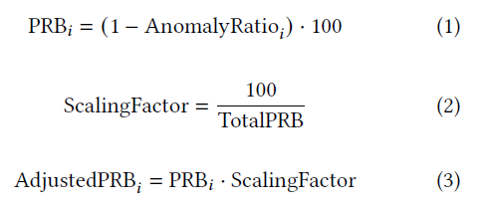
Major Contributions: xApp
It Listens for the ATD messages and for each message it extracts the UE ID, S-NSSAI, and the anomaly ratio per UE.
Then it uses the below formula for calculating the new allocation of PRB’s
So as the number of malicious packets for a UE increases, the number of PRB’s allocated to that specific UE decreases.
When the anomaly ratio reaches 100% the xApp classifies it as an attack and triggers an RRC Connection release, causing the malicious UE to disconnect from the network.
And as a result more PRB’s gets allocated to the benign users increasing their throughput.

Slide 31
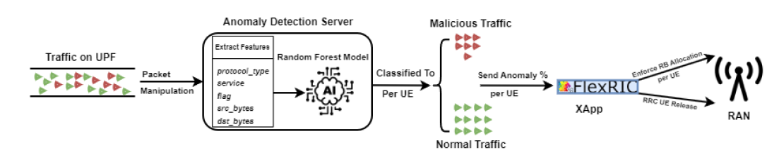
System Architecture

Slide 32
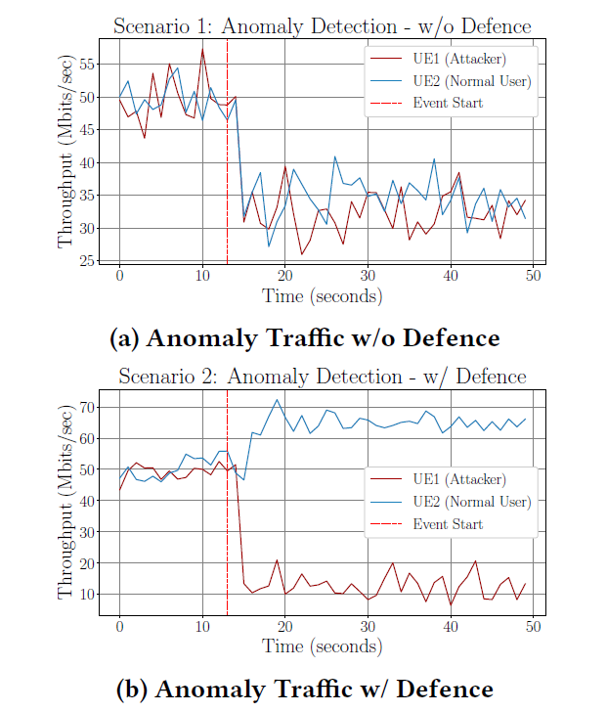
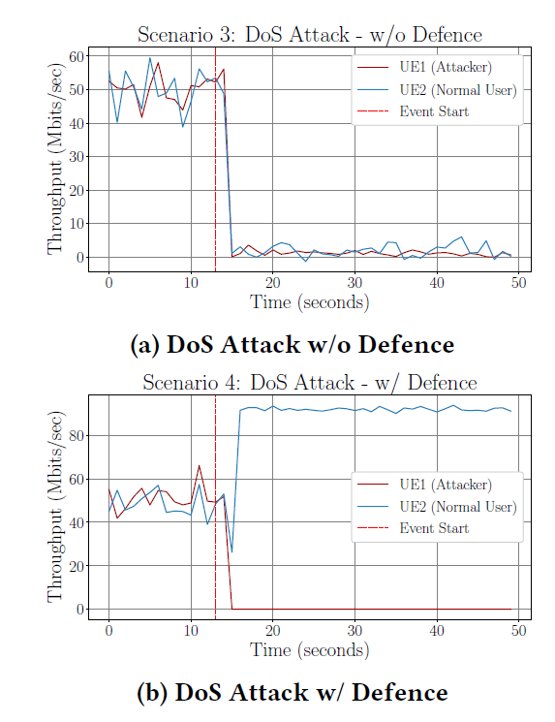
Evaluation

Slide 33
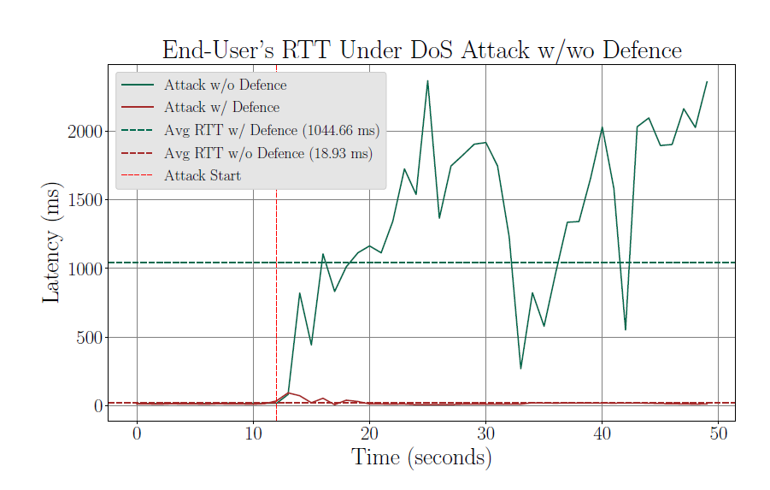
Evaluation

Slide 34
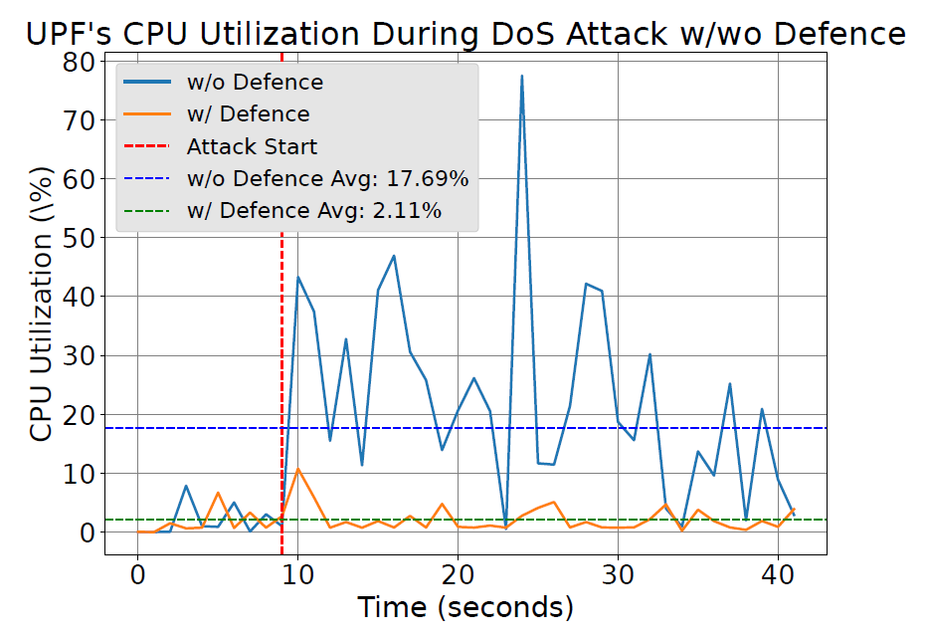
Evaluation

Slide 35
A Survey for Intrusion Detection Systems in Open RAN
Amachaghi, Emmanuel N., et al. "A Survey for Intrusion Detection Systems in Open RAN." IEEE Access (2024).

Slide 36
Overview
The paper addresses security challenges posed by the disaggregated and open architecture of O-RAN, with a specific focus on the need for IDS.
Provides a comprehensive review of IDS solutions.
Disaggregation introduced more interfaces and more integration points.
Open interfaces are accessible via standardized API’s, which can be exploited for unauthorized access, MITM, injection attacks or malware distribution, expanding the attack surface.

Slide 37
Major Contributions
Examines the existing literature and case studies to highlight the importance of IDS
Applications :
1. Anomaly detection : detects abnormal patterns in the heavy traffic.
2. Behavioural analytics : identifies insider threats, compromised devices and unauthorized activities that may pose security risks by correlating multiple data sources.
3. Threat hunting response : proactive process of searching for cyber threats that may be lurking undetected in the network

Slide 38
Methodologies
IDS : detecting anomalies → outliers, changes, drifts
Types :
Signature based IDS : detects known threats
Anomaly based IDS : detects unknown threats, ML powered
Heuristic based IDS : rule driven detection
Behaviour based IDS : monitors user/device traffic
Hybrid based IDS : combines multiple approaches
Machine learning based IDS : adaptive and predictive

Slide 39
AI/ML IN O-RAN SECURITY
Security benefits it offers :
Real time anomaly detection
Behavior analytics
Predictive threat modeling
Automated threat hunting and response

Slide 40
Future Work

Slide 41
Idea-1: Find Some Novelty
AI/ ML technique used
Use some different learning technique like unsupervised/ semi-supervised learning instead of supervised learning which is implemented by most of the works
Come up with another architecture which might involve multiple filtering stages/ different mixing of models/ Unique pre-processing techniques etc… to either improve the accuracy or reduce the training/ inference time.
Systems Side -> We still have to see works available on this
Include the Slicing parameter -> Only If Slicing Info is available in the dataset itself
Consider a time series data (To identify Attack Patterns) -> if we can get such a dataset using Bubble RAN or doing a slight modification in FALCON

Slide 42
Idea-2: Comparative Analysis of Datasets and Various IDS Techniques
Compile a Analysis of the most used datasets for intrusion detection.
Implement using various AI/ML Algorithms discussed in the literature
Also try to build IDS from scratch and compare your work with the work in literature
It will help us to understand Intrusion detection in a better way and also it will develop our ability to do Intrusion Detection on given datasets.
It will act as reference point for the upcoming students/Interns and they do their work on the top of it.

Slide 43
Project 1 - comparative analysis of datasets and various IDS techniques.
OVERVIEW
Aim : To evaluate how the performance of various IDS is influenced by different publicly available datasets.
Methodology : Applying a consistent set of machine learning and deep learning models across multiple datasets.
why : To analyze how data characteristics such as feature richness, attack types, class distribution and temporal patterns affect detection accuracy, false alarms and general model effectiveness.
What does it consist : data selection, preprocessing, model selection, experimental setup, and performance evaluation.
Helps in : pick the right model for the dataset, understand limitations of each dataset.

Slide 44
IDS techniques to be evaluated discussed in the literature :
Efficient intrusion detection system : extra tree classifier → dimensionality reduction technique, stack ensemble learner → base learners : decision tree, logistic regression, naive bayes ; meta learner: decision tree.
AI for IDS in 6G : Federated learning (with blockchain encryption)
AI driver for IDS resource allocation : random forest, one-class SVM, local outlier factor, KNN, autoencoder.

Slide 45
Dataset selection
Edge-IIoT dataset :
KDD Cup 1999 Data
ITU2021 | ML5G PHY
TON_IoT dataset
FBS Detection

Slide 46
Methodology outline :
Preprocessing each dataset
Standardize formats, encode labels, scale features
Handle missing values or class imbalance
Train each model on each dataset :
Apply the same pipeline for all the models (split into train/validation/test sets)
Model training :
Train each IDS model on the same training set of a dataset
Evaluation :
Evaluate each model on the same test set using identical metrics like : accuracy, precision/recall/f1-score, ROC-AUC, detection rate(true positive rate), false positive rate

Slide 47
Repeat across all datasets
For each IDS model, this exact pipeline is repeated independently on all datasets.
This avoids unfair advantages like one model seeing more data or being tuned more carefully
Benefits of a common pipeline :
Fairness : all models are judged under the same condition
Reproducibility : easy to replicate and compare in future studies
Clarity : clear view of how each model performs across different data types.

Slide 48
Comparative analysis of various datasets and various ML techniques.
Edge IIoT Dataset, KDDcup99

Slide 49
Edge IIoT Dataset for ML:
Loading and cleaning the dataset
Load the ml-edge_iiot dataset for training the model
Check for missing, infinite values, dropping the duplicates.
Label encoding/ one-hot encoding if necessary for the categorical features
Feature scaling :
Normalization/ standardization according to the needs
Feature selection using correlation analysis
Class balancing
The dataset has major attack class, so smote can be used to oversample the normal traffic to train the models
train/test split
The data is divided into training and testing sets.
Implementing the classic ml models
Logistic regression, decision tree, random forest, KNN, naive bayes, XGBoost

Slide 50
KDDcup99 Dataset
Loading and cleaning the dataset.
Load the dataset kddcup.data_10_percent.gz for training the model.
Check for missing or infinite values, dropping the duplicates.
Mapping labels to each class
One hot encode for categorical features
Feature scaling and normalization
Manually dropping features based on domain knowledge
Standardization of the dataset for the linear models
Feature selection - using correlation analysis, feature importance (based on the dataset)
Feature extraction if necessary using PCA
Class weights or smote for balancing the dataset
Implementing the classic ml models
Logistic regression, decision tree, random forest, KNN. naive bayes, SVM, XGBoost
And can experiment with ensemble learning techniques.

